Slide 1
A breakthrough year in robot theatre?
2008

Slide 2
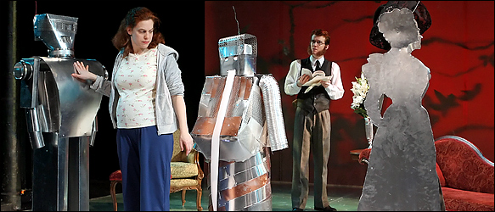
Henrik Ibsen in "Heddatron," the dopey and strangely moving gloss on "Hedda Gabler" by Les Freres Corbusier at the Here Arts Center in the South Village.
Designed by Cindy Jeffers and Meredith Finklestein of Botmatrix, a robot arts collective,
March 2008

Slide 3
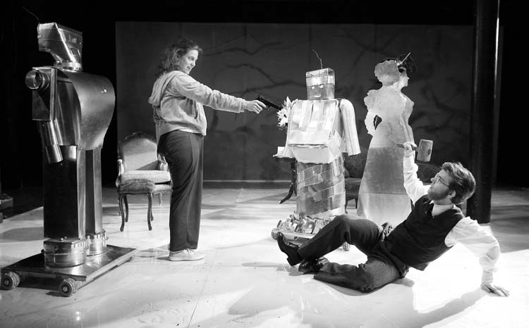

Slide 4
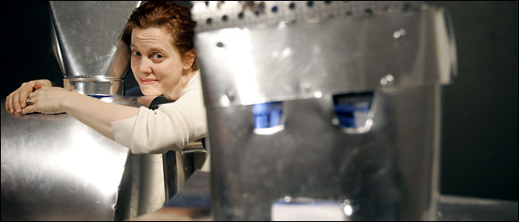
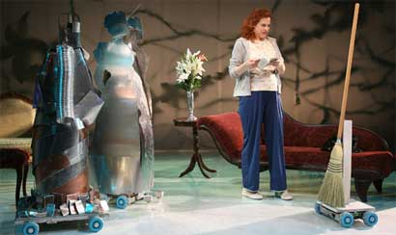

Slide 5
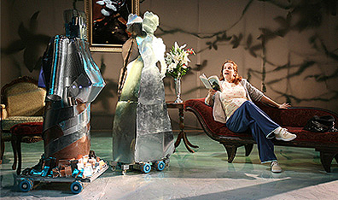

Slide 6
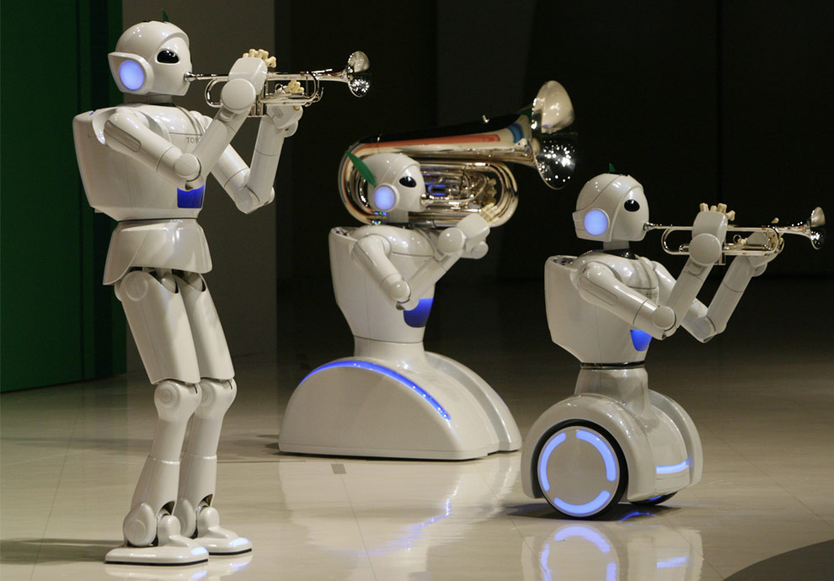
Toyota Motor Corporation partner robots play instruments at the company's showroom in Tokyo on May 4, 2008.
May 2008

Slide 7
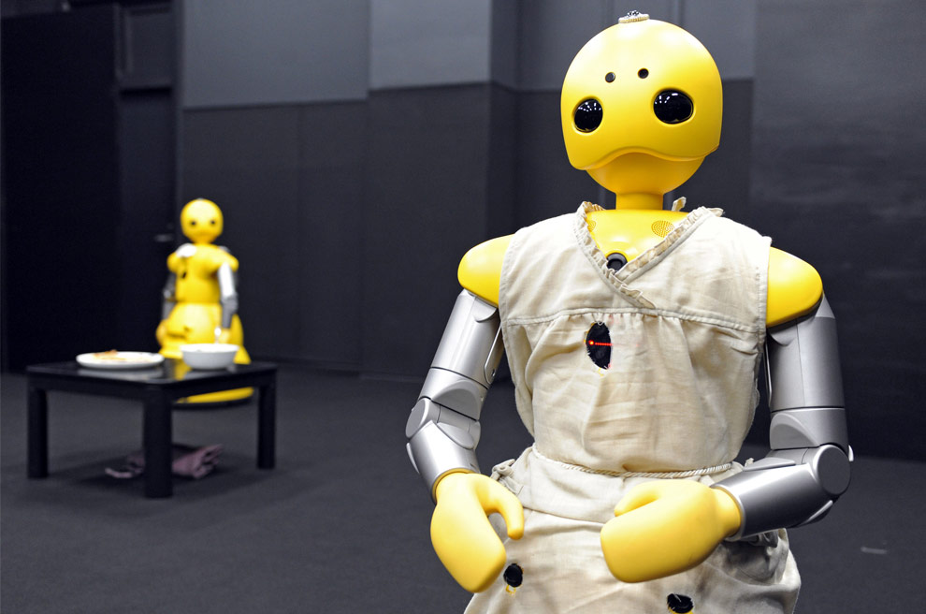
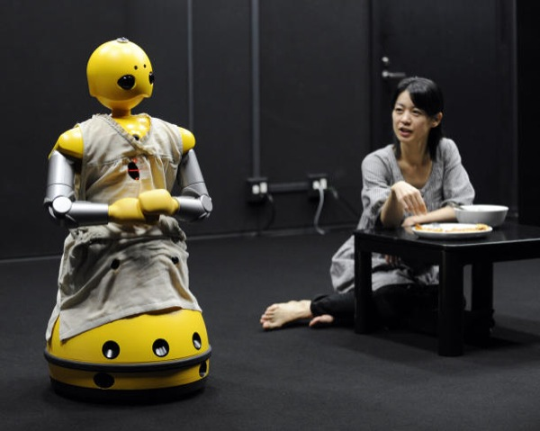
Humanoid robots Wakamaru, produced by Japan's Mitsubishi Heavy Industry, named Momoko (R) and Takeo (L) in the performance, take part in a drama for the world's first robot and human experimental theatre, written and directed by Japanese playwright Oriza Hirata, at Japan's Osaka University in Osaka, western Japan on November 25, 2008.
Commercial robots of mobile base/hands/head type.
by Mitsubishi
more commonly used as a house-sitter, secretary or companion for the elderly.
Actors and robots.
November 25, 2008.

Slide 8
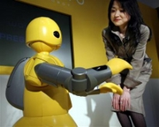
Tells a futuristic tale of a housekeeping robot who becomes bored with its allotted role in society as a demeaning cleaner.

Slide 9
20-minute performance
robots faultlessly delivered their lines
interacting with their real-life counterparts.
Osaka University
playwright Oriza Hirata
hoping to expand it to full production length for the public by 2010.
The alliance between humans and robots performing together live on stage is believed to be a first for Japan's robotics industry.

Slide 10
The Wakamaru robot uses a laser and cameras to track and identify objects and people.
It also has the capacity to remember and recognise around 10,000 words necessary for communication in daily life.

Slide 11
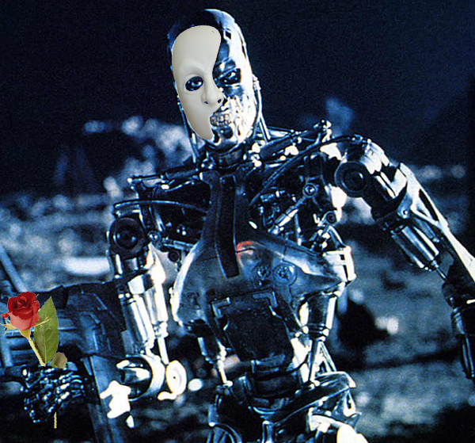
Taiwan casts robots in Phantom of the Opera
The University of Science and Technology in Taiwan's announced that they're putting on a very special performance of The Phantom of the Opera on December 27th, 2008, in which the two leads will be played by robots.
The lead bots (named Thomas and Janet) can both walk, and have silicon facial "muscles" that help them mimic human expressions and mouth movements.
December 27th, 2008

Slide 12
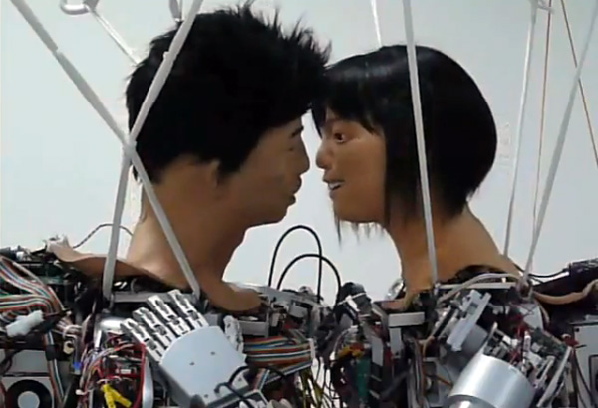
Our humanoid friends started engaging in public displays of affection.
Exhibit A: Thomas and Janet, two performance bots who made out publicly in front of hundreds during a December 2008 robotic production of "Phantom of the Opera" in Taiwan
A team at National Taiwan University of Science and Technology spent three years developing and programming the smooching bots, which with the help of servo motors that pull at the face and mouth

Slide 13
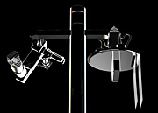
Barnabe Theatre in Servion, Switzerland
Robots – the musical,
May 1 – May 17, 2009
May 1 – May 17, 2009

Slide 14
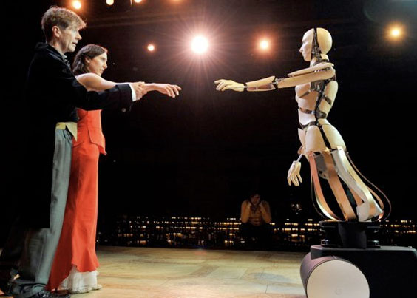
2

Slide 15
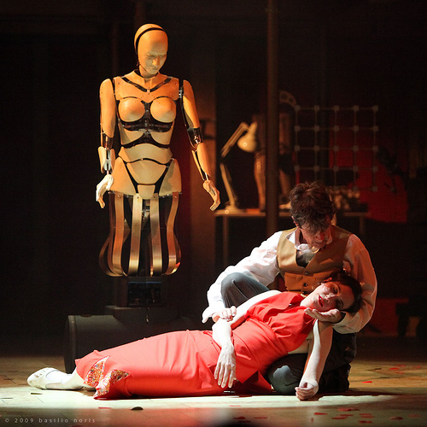
It’s a musical that stars three autonomous robots developed by Bluebotics, a company that makes service bots. Ah, so there’s some promotion involved here

Slide 16
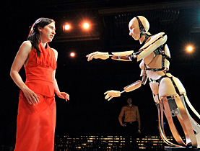

Slide 17
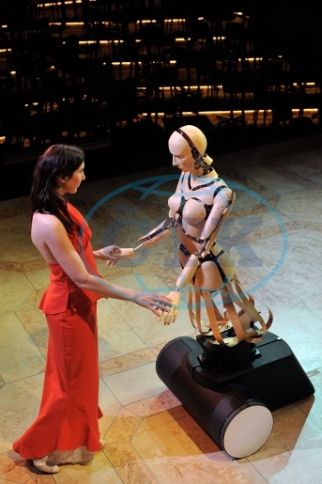
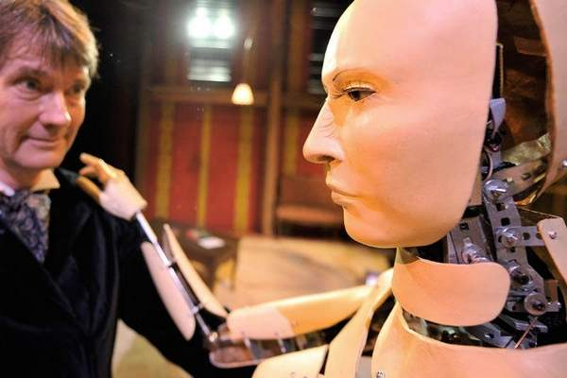
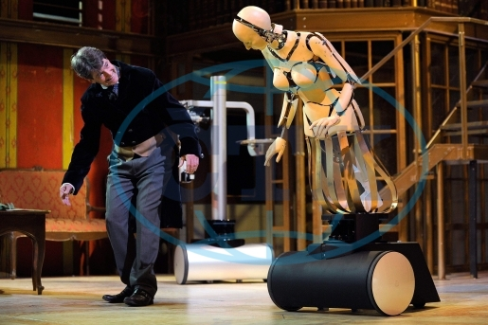

Slide 18
The Japanese robotics market is currently valued at an estimated £4.9 billion (Y712.3billion)
This is forecast to boom to £66billion (Y9.63 trillion) by 2030, according to the Japan Robot Association.

Slide 19
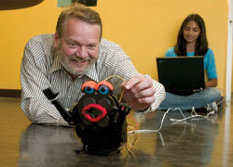
Robot Theatre Research at PSU

Slide 20
2001

Slide 21
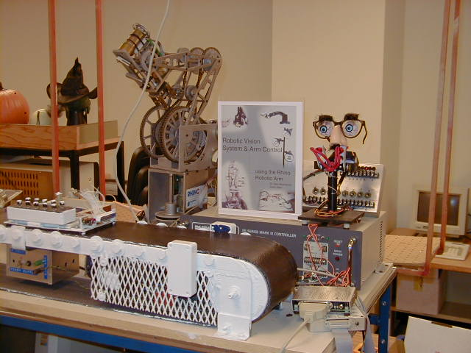

Slide 22
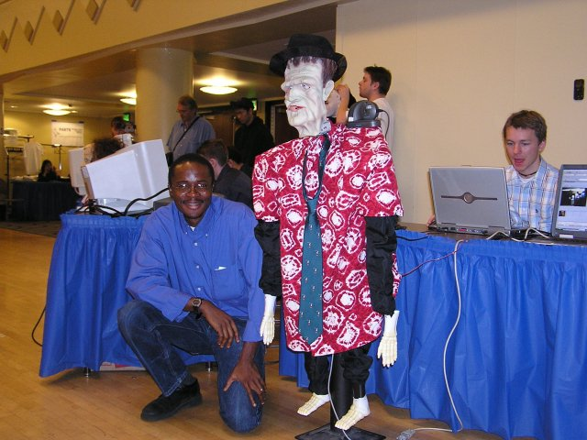
Steve, Professor Perky and Normen at Intel's show.

Slide 23
2003
KAIST Hahoe Robot Theatre

Slide 24
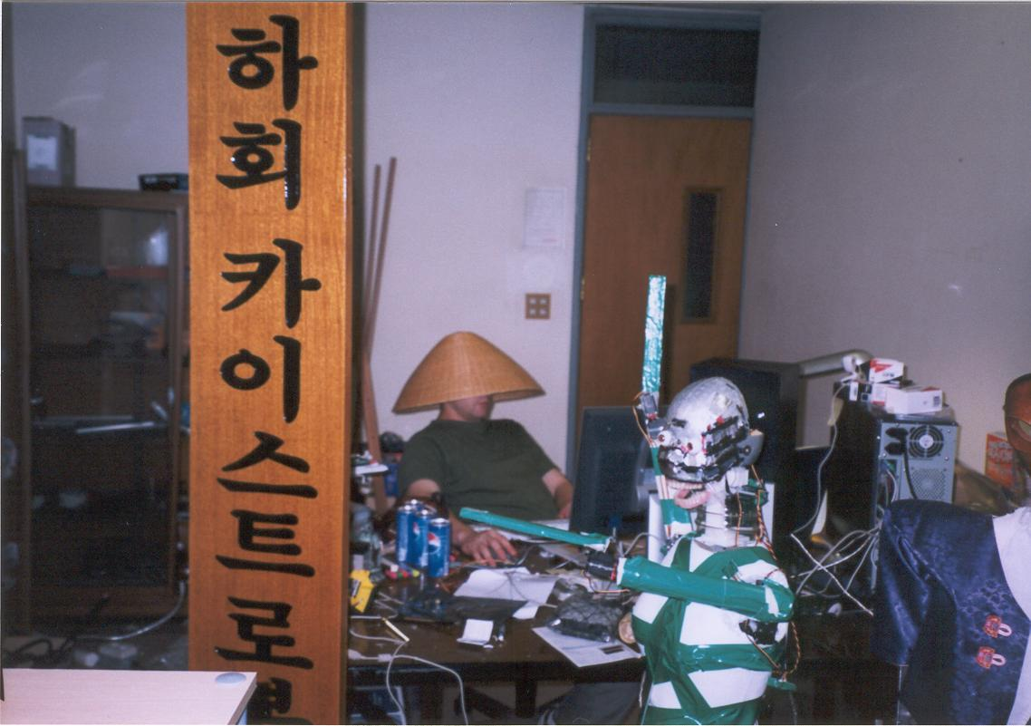
The Hahoe Robot Theatre

Slide 25
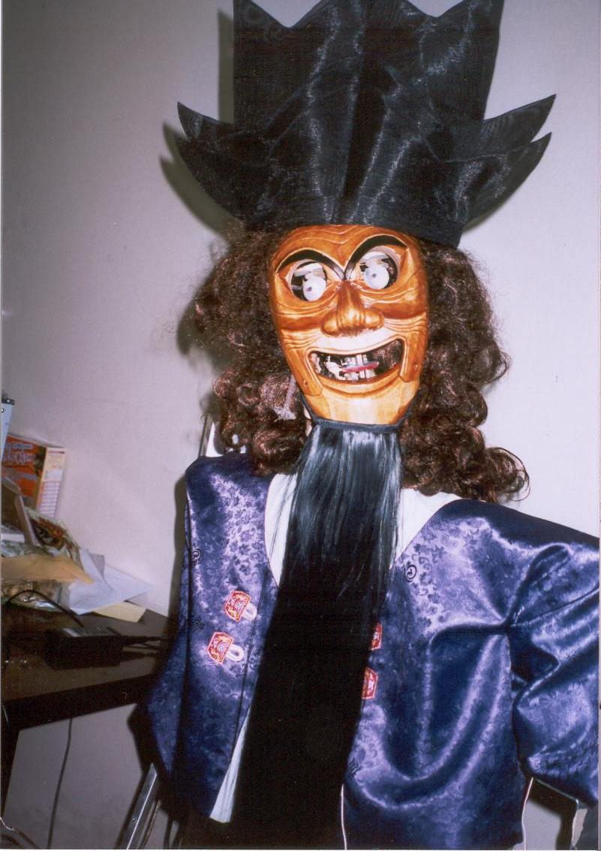
Sonbi – the Confucian Scholar

Slide 26
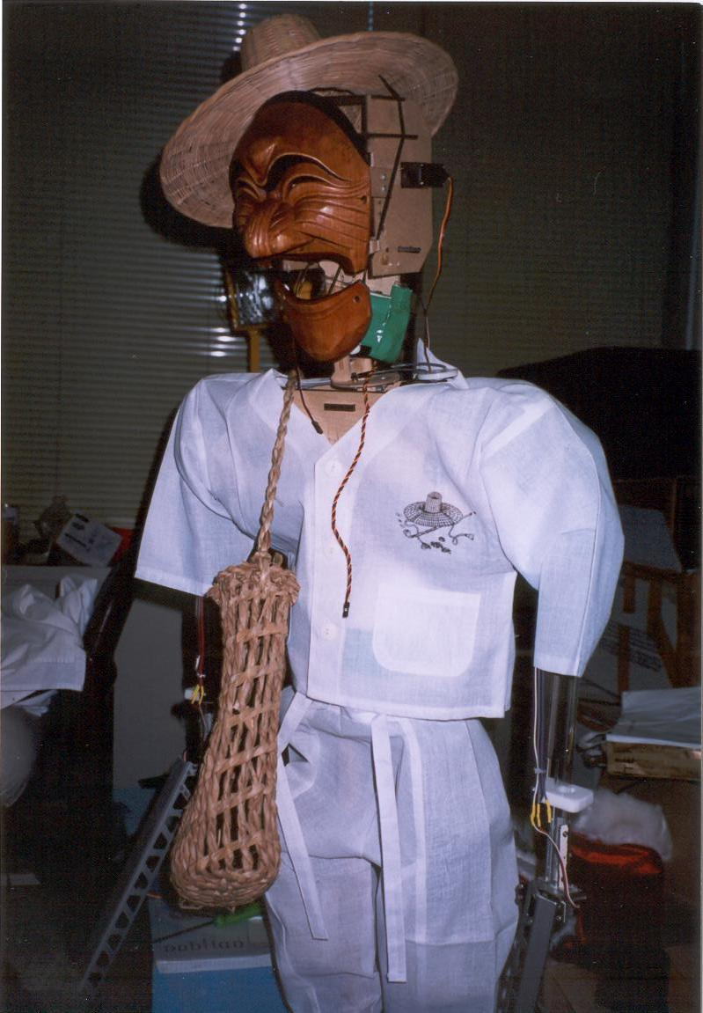
Paekchong – the bad butcher

Slide 27
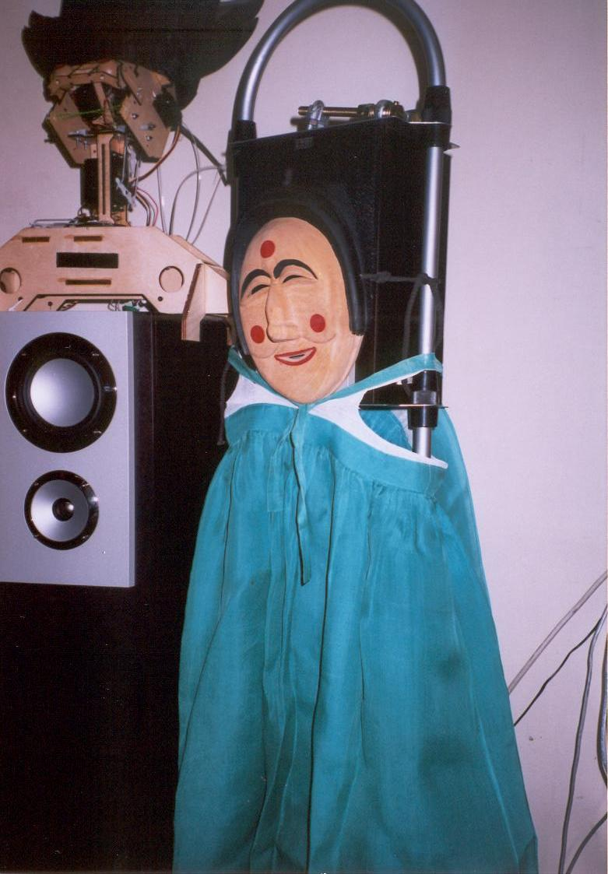
Yangban the aristocrat with Pune his concubine

Slide 28
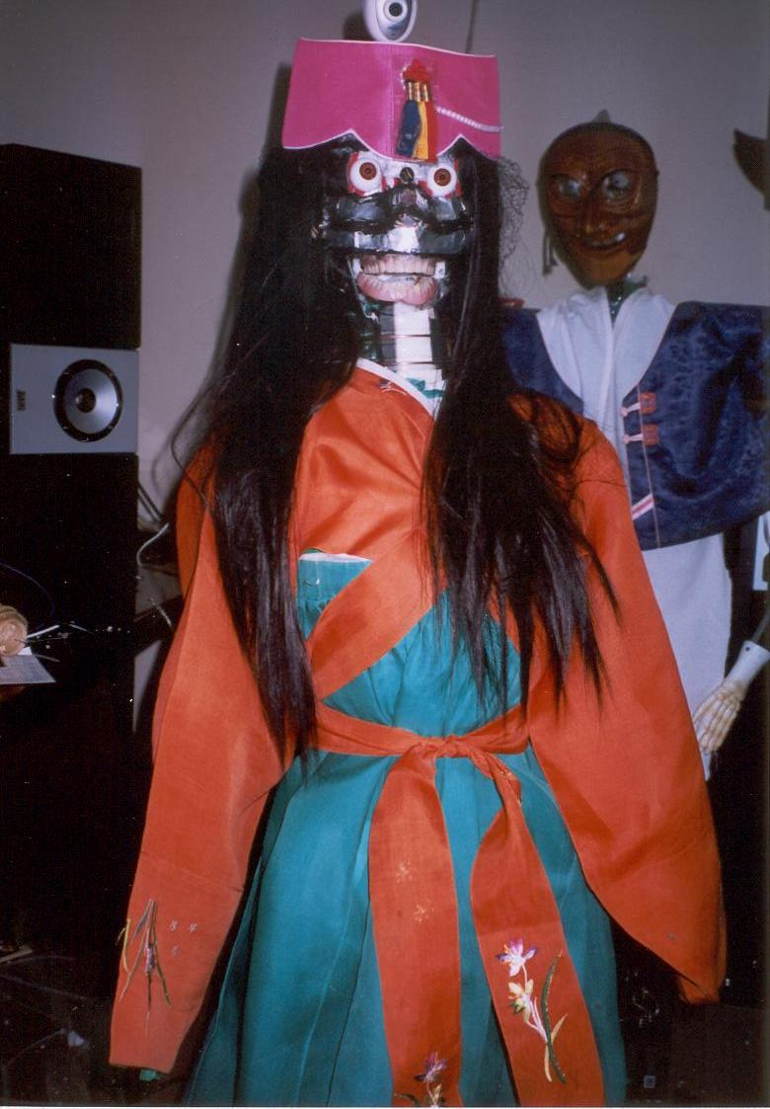
The interpreter robot without face skin

Slide 29
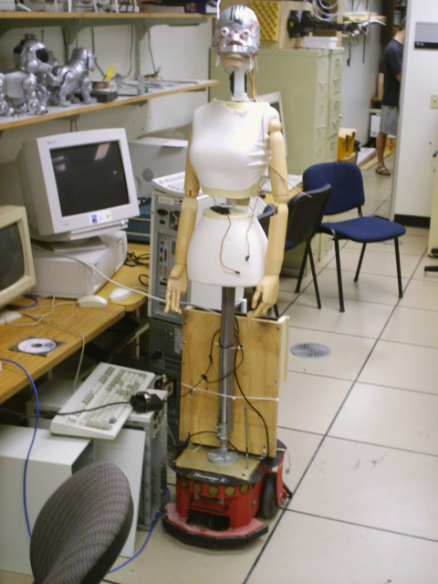
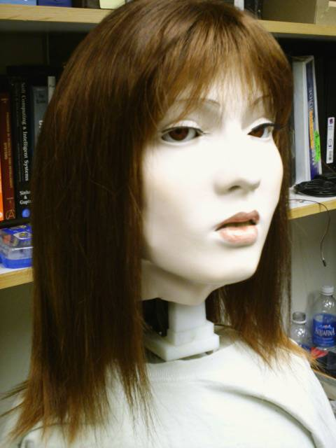
The same robot 2004, June

Slide 30
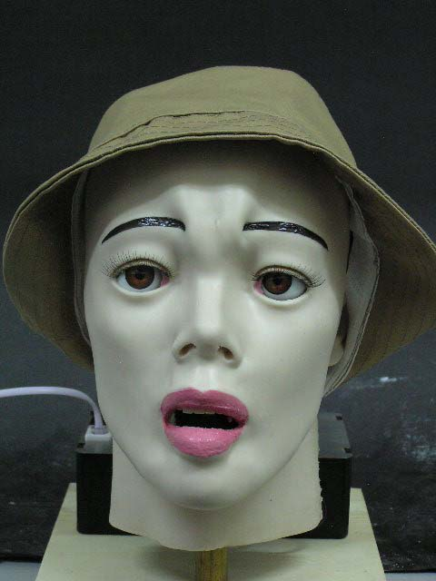
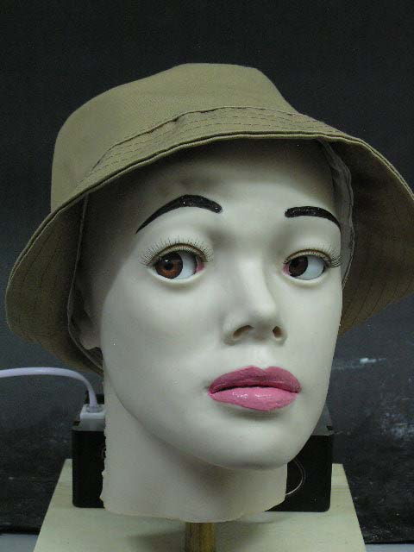
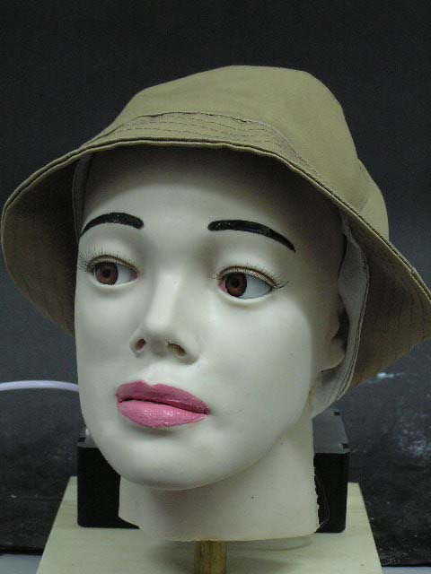
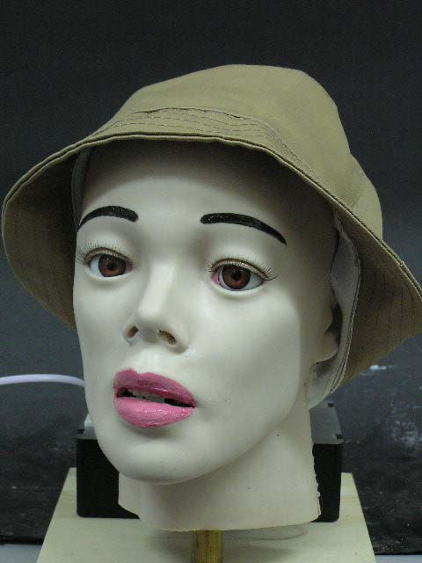
Hahoe Pyliyshyn, new head
Emotional Robot Head – the interpreter

Slide 31
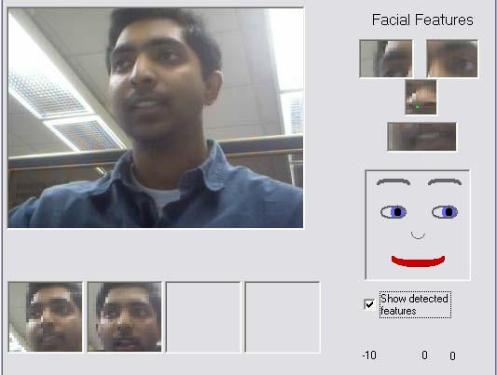
Face features recognition and visualization.

Slide 32
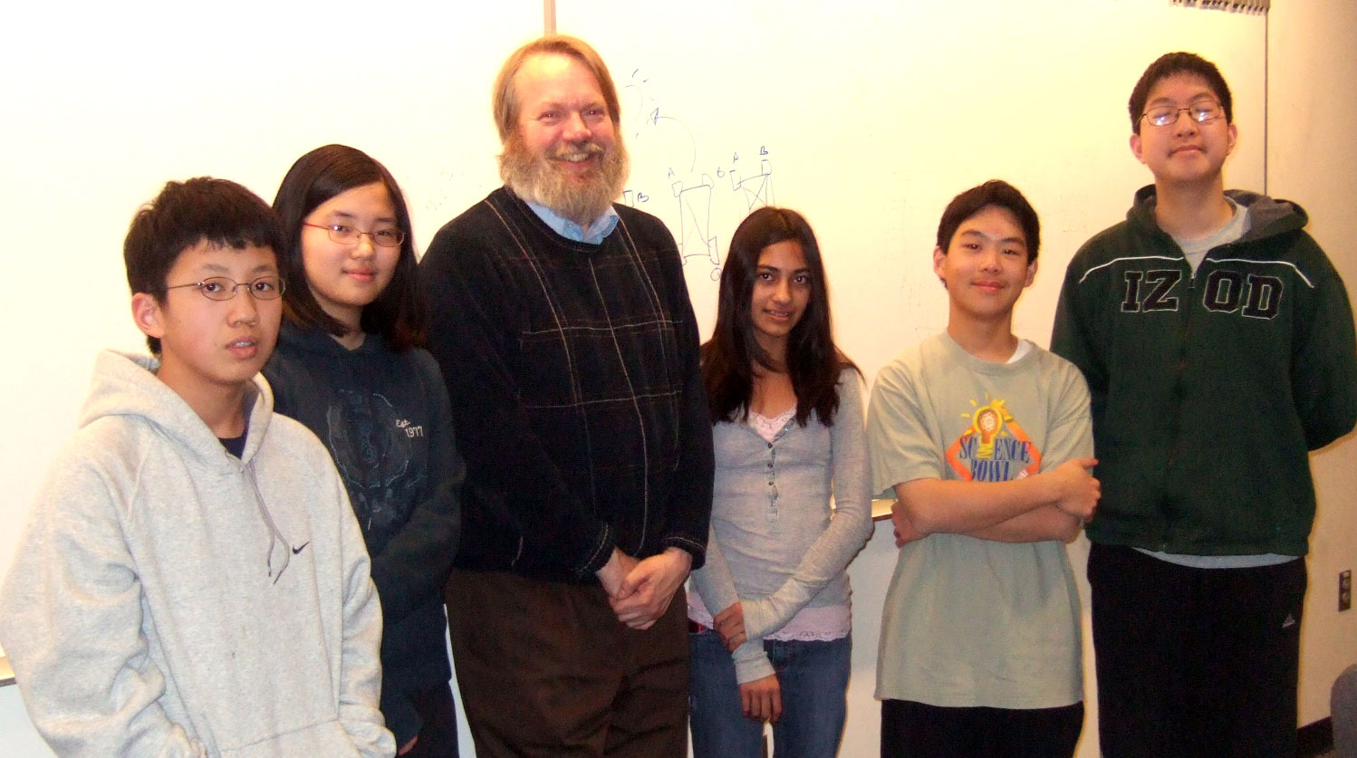
2009 “What’s That? Schrödinger Cat”
a debate between Einstein and Schroedinger Cat about quantum mechanics –
an educational theatre.

Slide 33
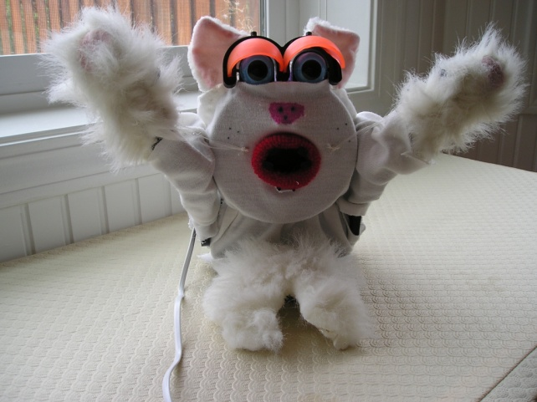
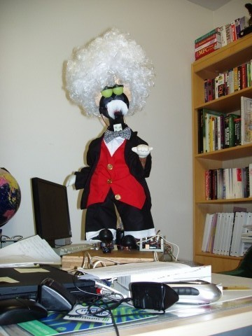
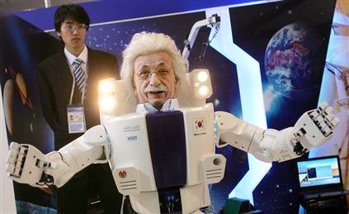
Improvisational Theatre “What’s That? Schrödinger Cat”
Schrödinger Cat
Professor Einstein

Slide 34
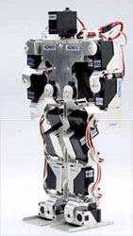
2010 - OUR RECENT
BIPED THEATRE
New version of Hahoe
To be shown in 2010
KHR-1
iSOBOT
Lynxmotion Systems

Slide 35
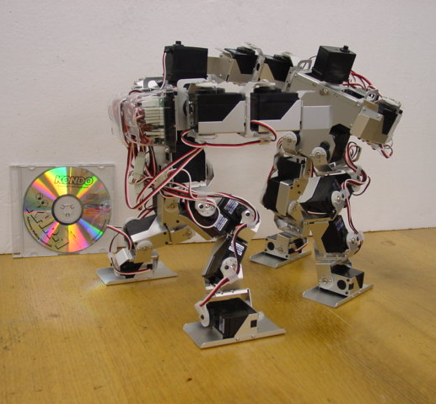
Walking biped robot can express the fullness of human emotions:
  body gestures,
  dancing,
  jumping,
  gesticulating with hands.
Emotions can be:
  Emergent - Arushi
  Programmed – Martin Lukac ISMVL
  Mimicked – ULSI
  Learned – Martin Lukac Reed-Muller
Fighting KHR-1 robots

Slide 36
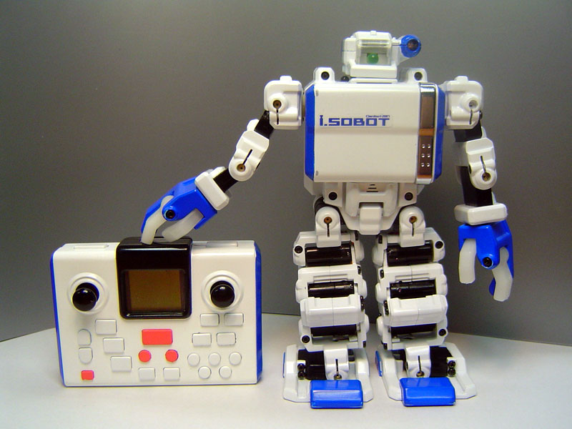
iSOBOT robot

Slide 37
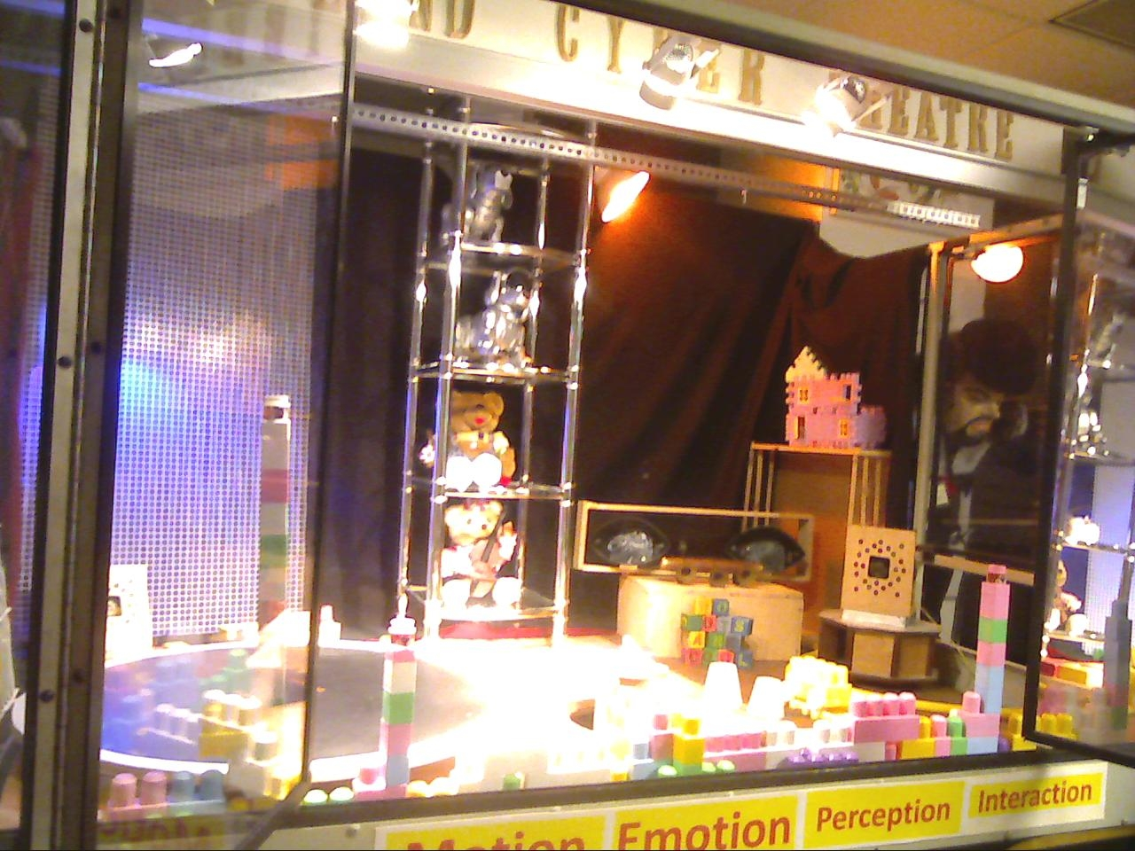
The stage of Portland Cyber Theatre in FAB building

